Slide 1
1) overview
COE used smart pointer to allocated objects on heap, even though, the memory leak will be happened. It’s difficult to find all memory leaks, many memory leaks will damage your software, and run out of your memory.

Slide 2
2) Use vld to detect memory leak
COE provided a powerful, free, open source tool named vld to detect the memory leak, vld is placed under 3rdparty folder and will only be used during your development period.

Slide 3
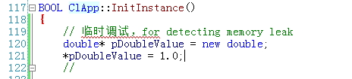
3) a sample to detect memory leak
In this section we provided a simple sample to illustrate how to produce and detect the memory leak. Please refer to the code pierce below, in ClApp::InitInstance() function of clApp module, we added some code which will generate the memory leak.

Slide 4
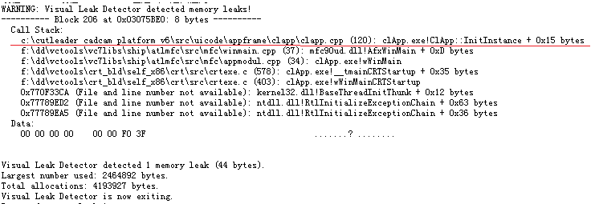
Then press F5 in VS to run the program, and shut down the program right now. Because we do not release memory of pDoubleValue variant, vld detected such memory leak and generated the report in the output area of VS IDE, please refer to the figure below, vld can find location where result in the memory leak.

